Slide 2
Unit 13:
WOULD YOU LIKE SOME MILK?
Lesson 1

Slide 3
Unit 13:
WOULD YOU LIKE SOME MILK?
Lesson 1

Slide 4
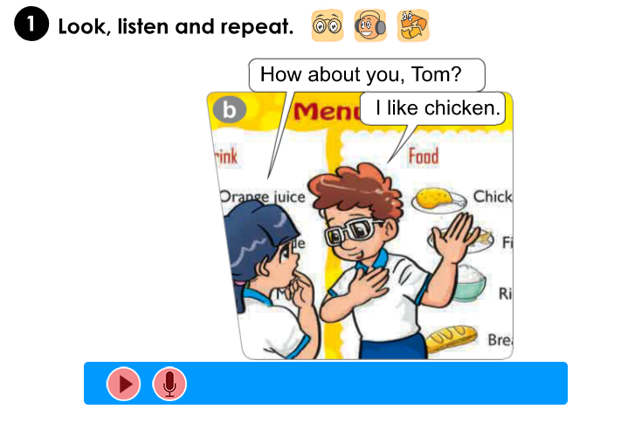
Unit 13:
WOULD YOU LIKE SOME MILK?
Lesson 1

Slide 5
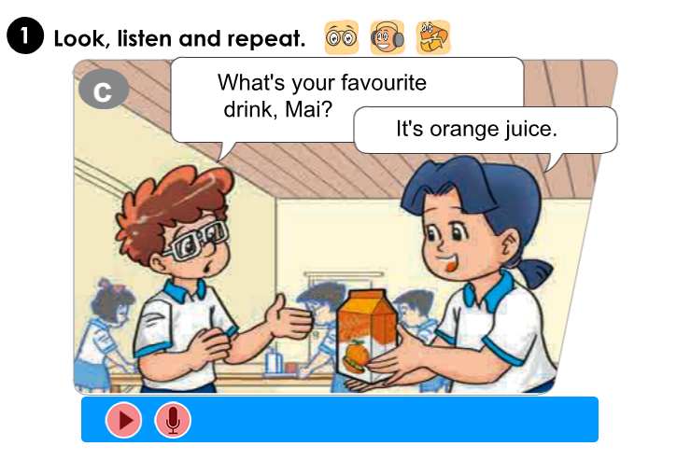
Unit 13:
WOULD YOU LIKE SOME MILK?
Lesson 1

Slide 6
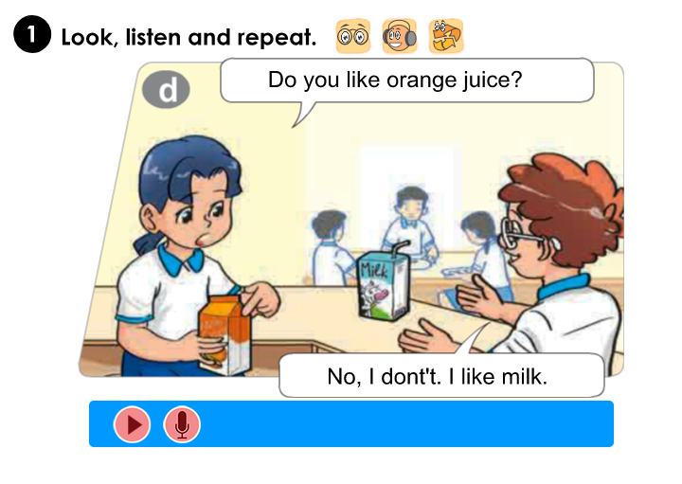
Unit 13:
WOULD YOU LIKE SOME MILK?
Lesson 1

Slide 7
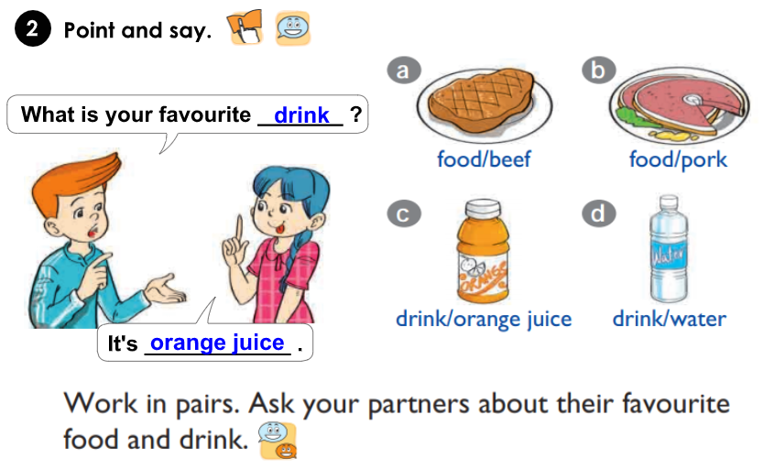
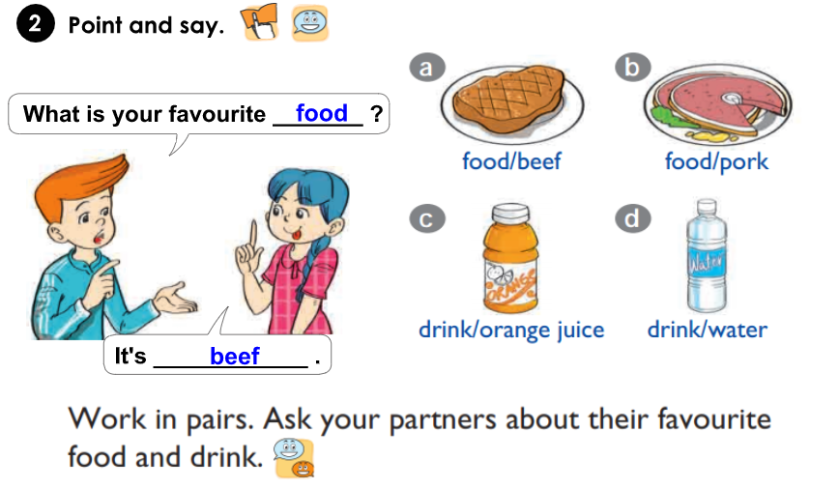
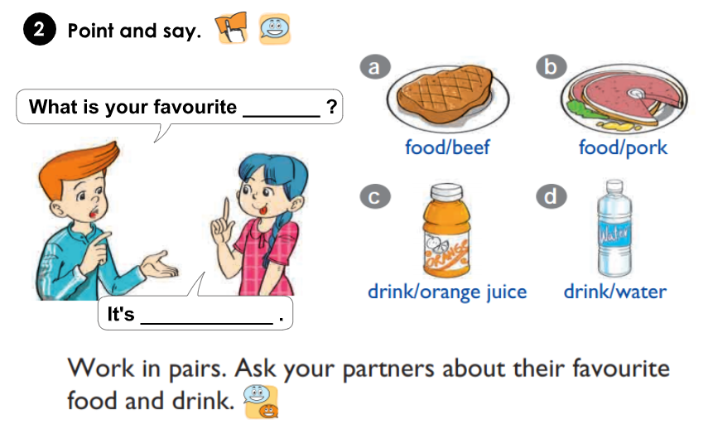
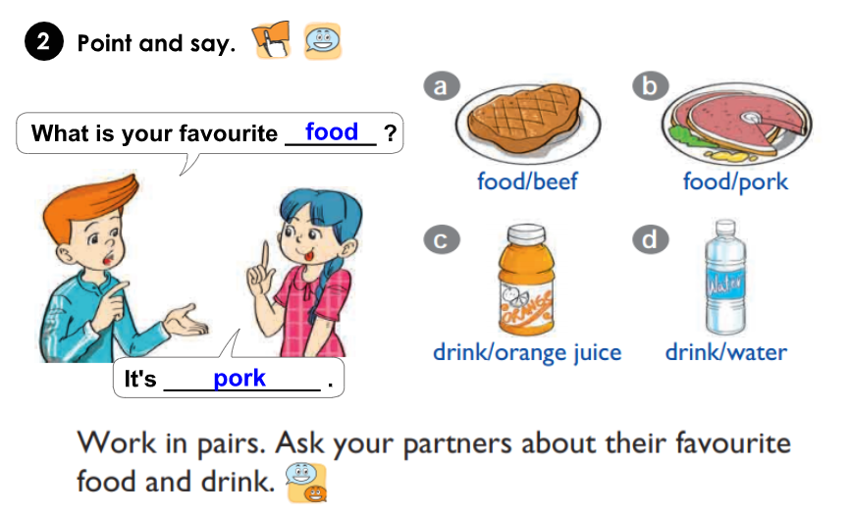
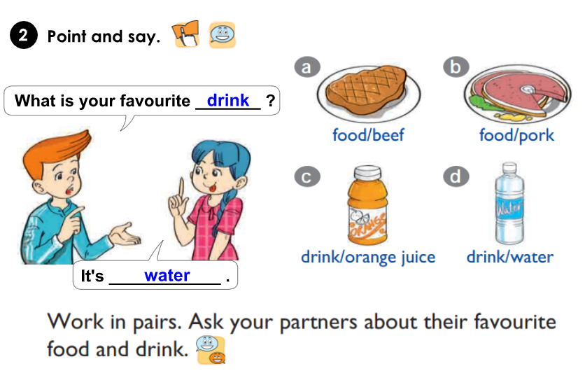
Unit 13:
WOULD YOU LIKE SOME MILK?
Lesson 1

Slide 8
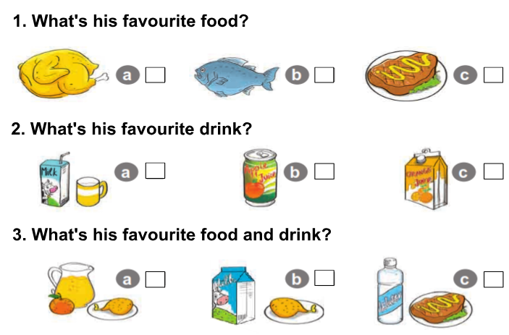
Unit 13:
WOULD YOU LIKE SOME MILK?
Lesson 1

Slide 9
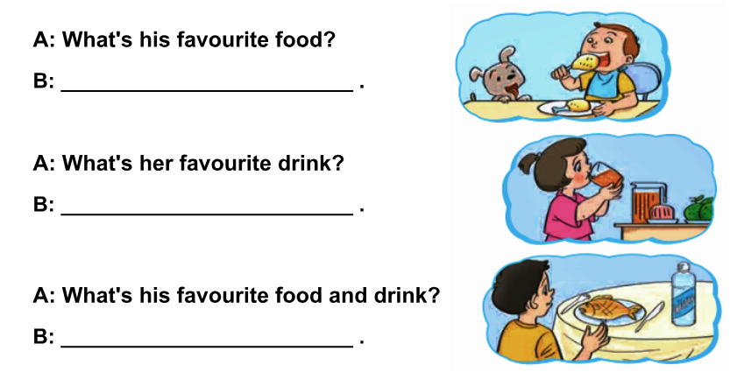
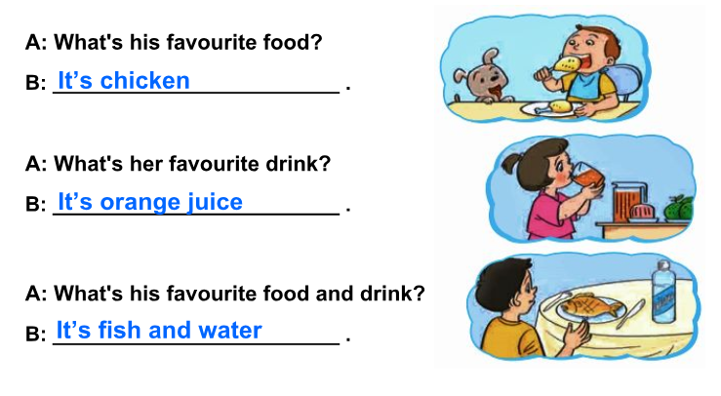
Unit 13:
WOULD YOU LIKE SOME MILK?
Lesson 1

Slide 10
Unit 13:
WOULD YOU LIKE SOME MILK?
Lesson 1

